Slide 1
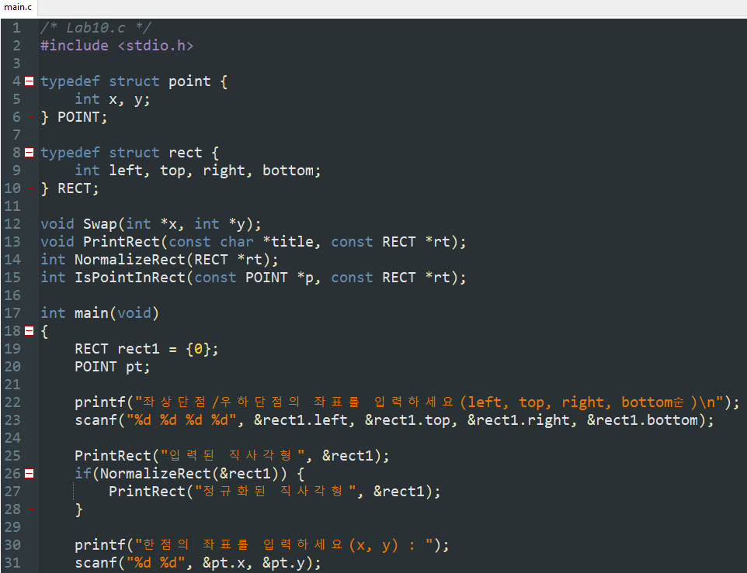
Chapter 10 Solution
실전과제 (1/3)

Slide 2
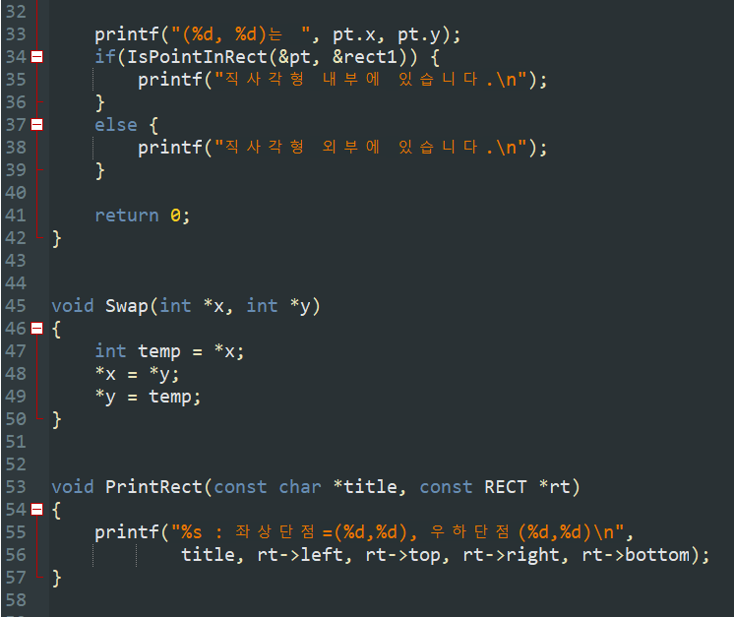
Chapter 10 Solution
실전과제 (2/3)

Slide 3
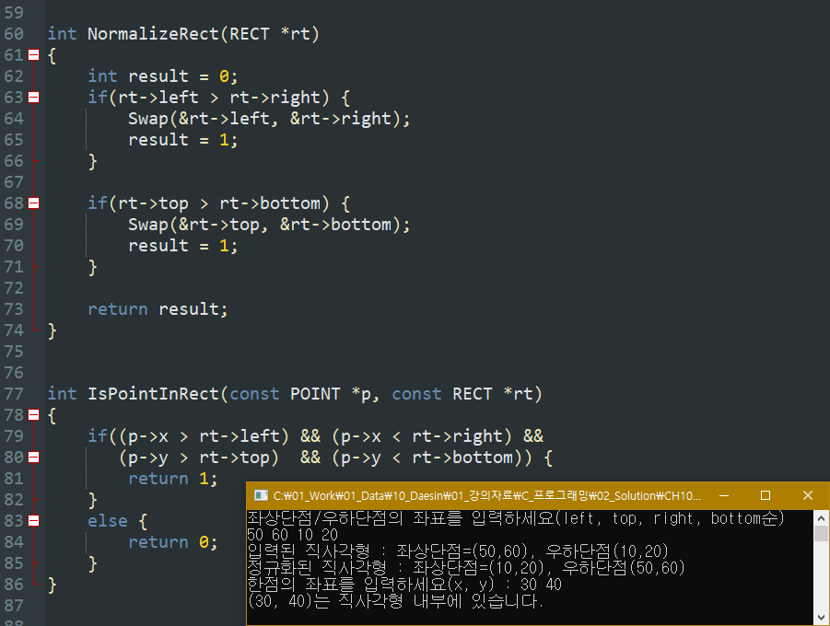
Chapter 10 Solution
실전과제 (3/3)

Slide 4
Chapter 10 Solution
연습문제
Num | Sol
9 | Recursive function(재귀함수)
10 | 공간적, 시간적 성능이 향상
11 | static
12 | ②, ⑤
13 | ①, ②, ⑥
14 | ①, ⑤
15 | char *s
16 | const POINT *p POINT *p p->x += xOffset; p->y += yOffset;
17 | a = 3, b = 3 a = 5, b = 15 a = 7, b = 105
Num | Sol
1 | ③, ④
2 | ⑤
3 | ②
4 | Passing by pointer (Call by pointer)
5 | double StandardDeviation(double *arry, int size); void StandardDeviation(double *arry, double *stdDev, int size);
6 | ②
7 | ④
8 | ②

Slide 5
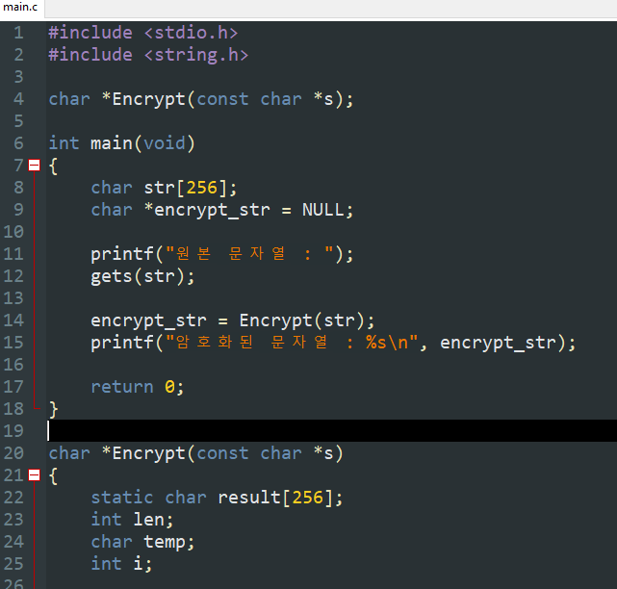
Chapter 10 Solution
연습문제 18
(1/2)

Slide 6
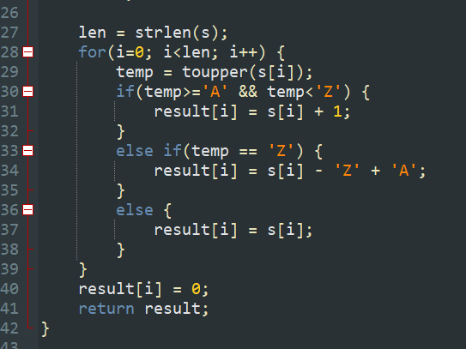
Chapter 10 Solution
연습문제 18
(2/2)

Slide 7
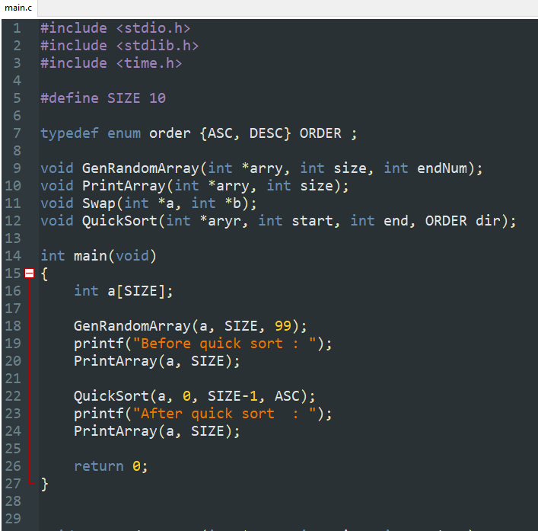
Chapter 10 Solution
연습문제 19
(1/3)

Slide 8
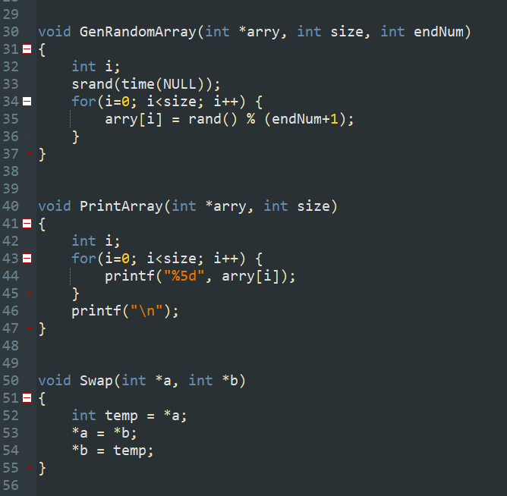
Chapter 10 Solution
연습문제 19
(2/3)

Slide 9
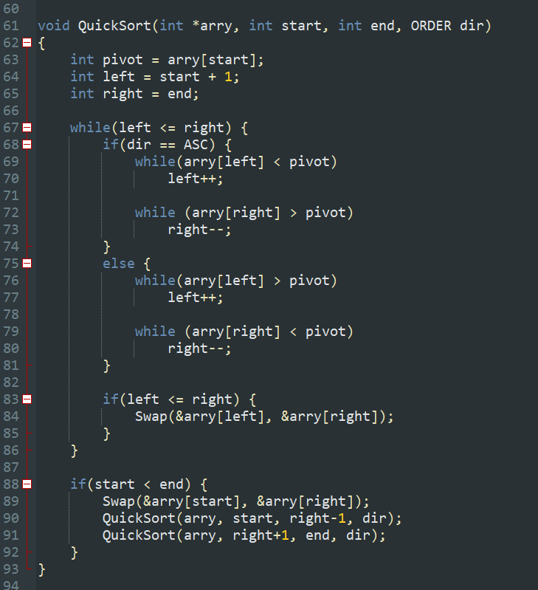

Chapter 10 Solution
연습문제 19
(3/3)

Slide 10
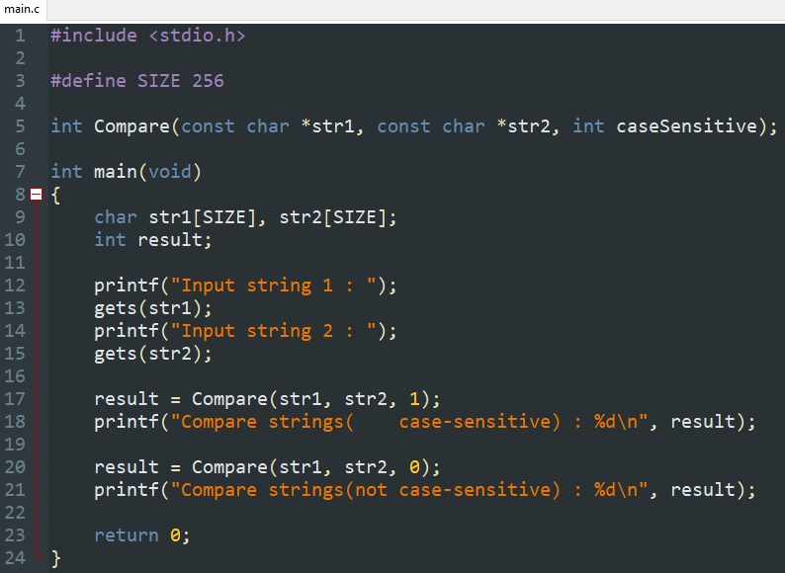
Chapter 10 Solution
연습문제 20
(1/2)

Slide 11
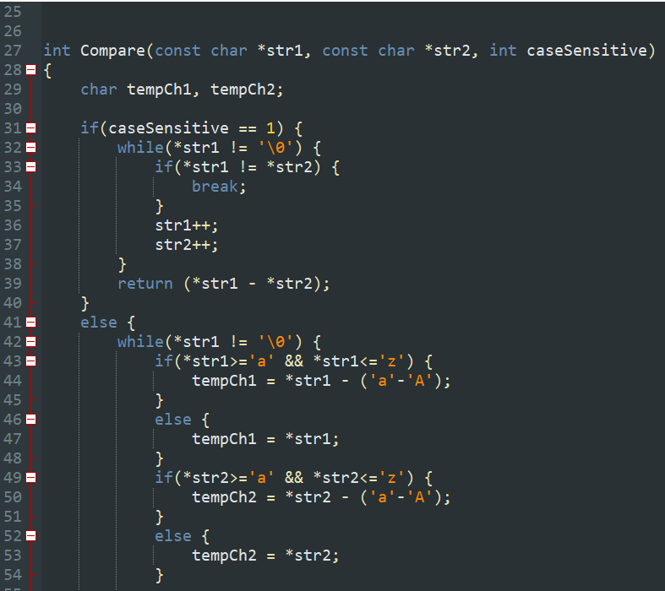
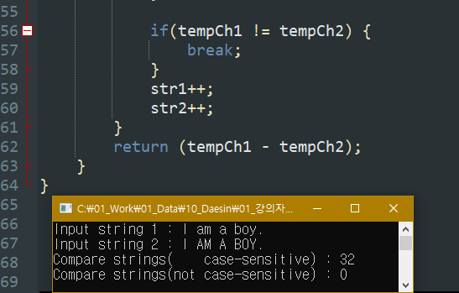
Chapter 10 Solution
연습문제 20 (2/2)

Slide 12
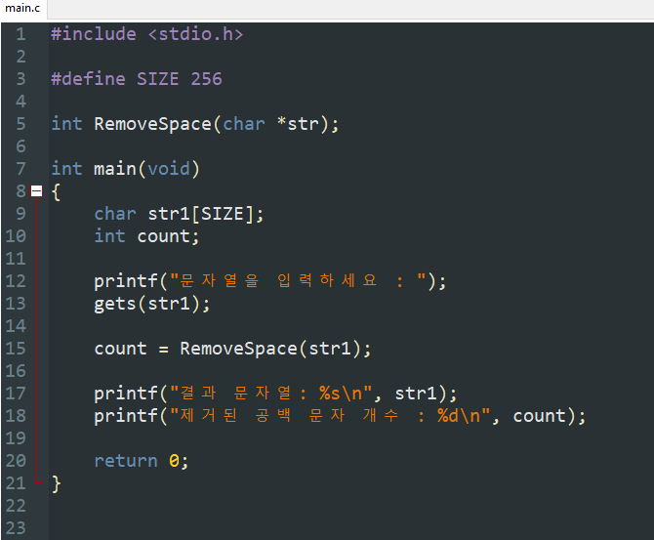
Chapter 10 Solution
연습문제 21 (1/2)

Slide 13
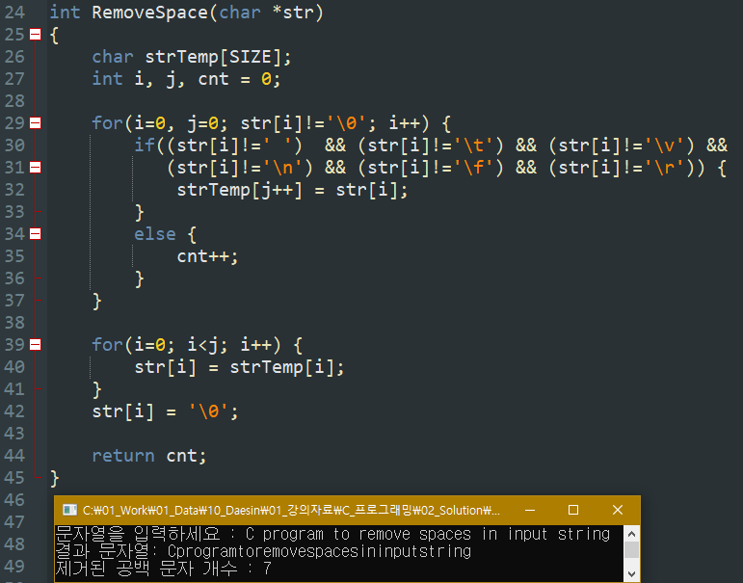
Chapter 10 Solution
연습문제 21 (2/2)

Slide 14
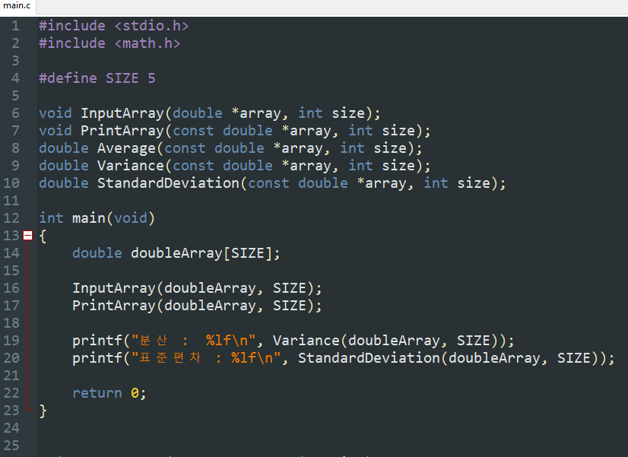
Chapter 10 Solution
연습문제 22
(1/4)

Slide 15
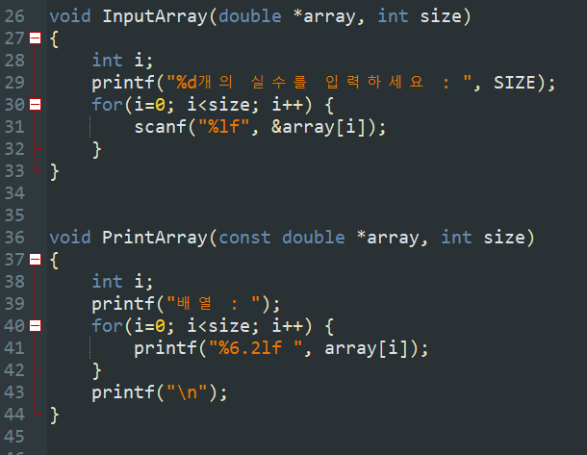
Chapter 10 Solution
연습문제 22
(2/4)

Slide 16
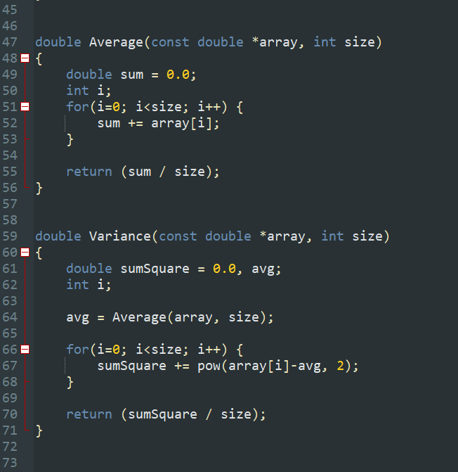
Chapter 10 Solution
연습문제 22
(3/4)

Slide 17
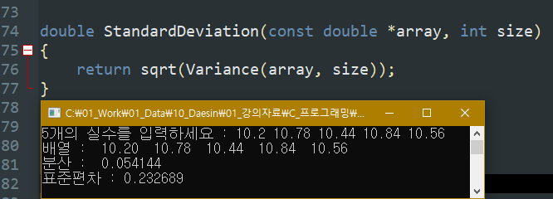
Chapter 10 Solution
연습문제 22
(4/4)

Slide 18
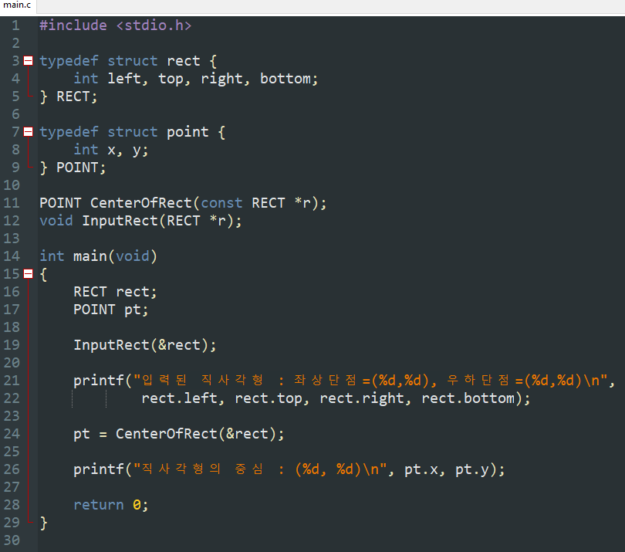
Chapter 10 Solution
연습문제 23
(1/2)

Slide 19
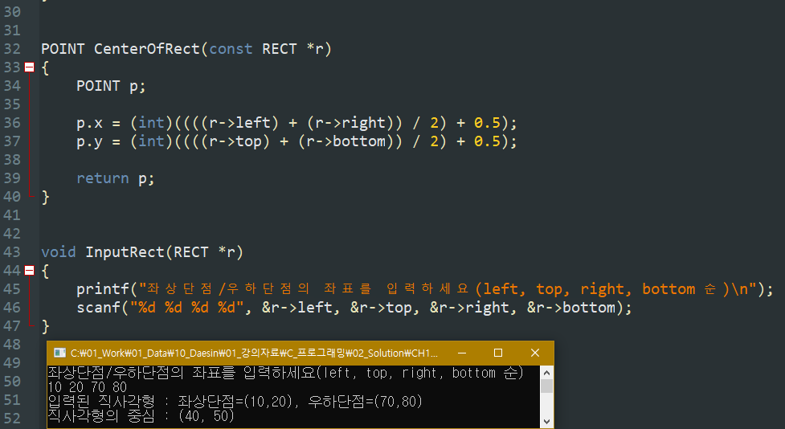
Chapter 10 Solution
연습문제 23 (2/2)

Slide 20
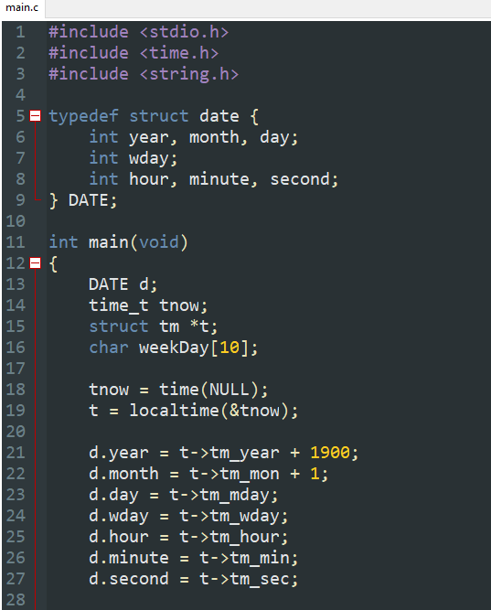
Chapter 10 Solution
연습문제 24 (1/2)

Slide 21
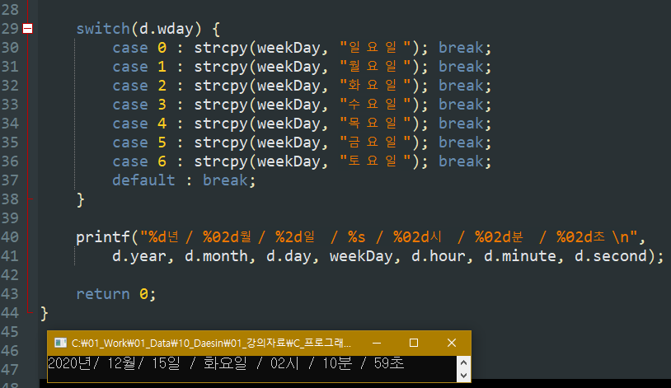
Chapter 10 Solution
연습문제 24 (2/2)

